Slide 1
Effectiveness of Covid Control: US Analysis
Sean Emerson, Patrick Minning, Lakshmi Shaji

Slide 2
The Genesis

Slide 3


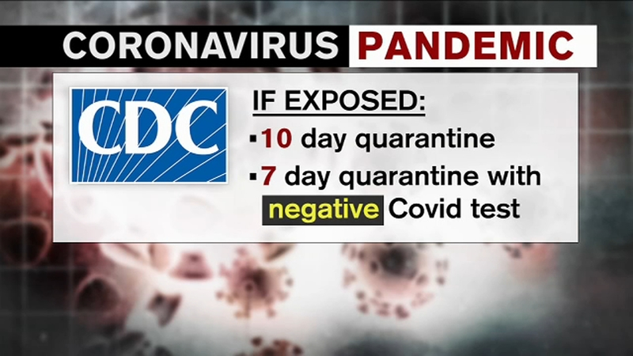
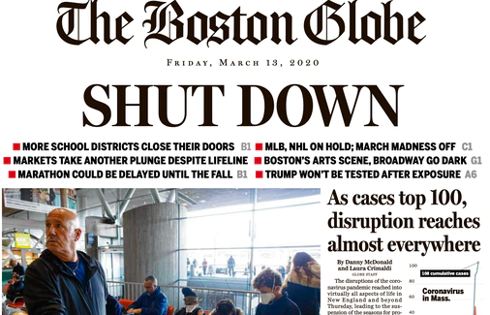

Our Year In A Snapshot
Notes:
Our year has been pretty hectic with the spread of COVID 19. Headlines were plastered with the news of the outbreak and as a result, the way that we have been living for the past year has also been impacted. Since it took over our everyday lives and kind of engulfed the world with a wide outbreak, we wanted to focus our project on COVID 19.

Slide 4
Questions We Proposed
How did state specific precautions differ in COVID-19 control effectiveness?
How does the population density of a state affect spread of COVID?
What is the relationship between lockdown period and success of controlling COVID?

Slide 5
Finding Data Sources

Slide 6



What kind of data do we need?
Lockdown periods among US states
US Population Data
Covid related information

Slide 7



Sources We Used

Slide 8
Data Clean Up / Analysis

Slide 9
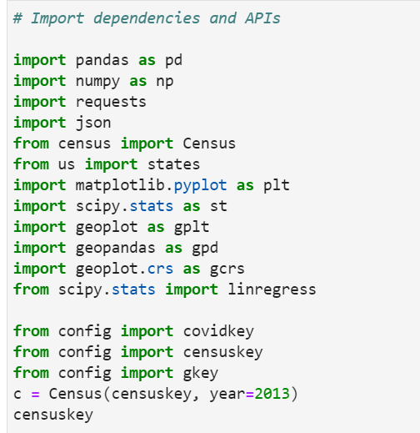
Dependencies and APIs
3 APIs
Covid Now
US Census
Google
12 libraries

Slide 10
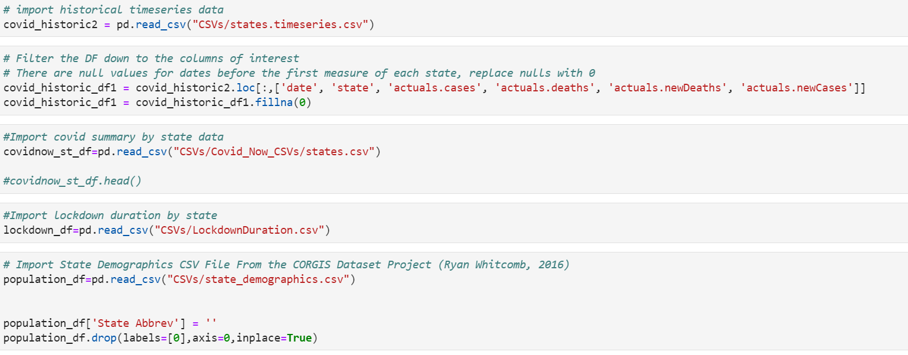
Building Dataframes
State population data (US Census)
Covid 19 statistics by state (Covid Now)
State population density (CORGIS Dataset Project)
2020 state lockdown duration

Slide 11
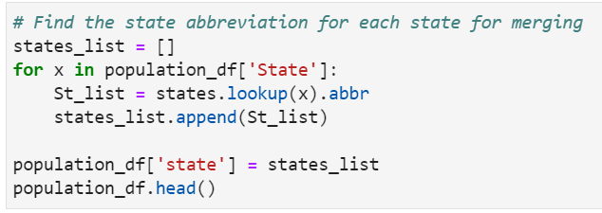
Merging Dataframes

Slide 12
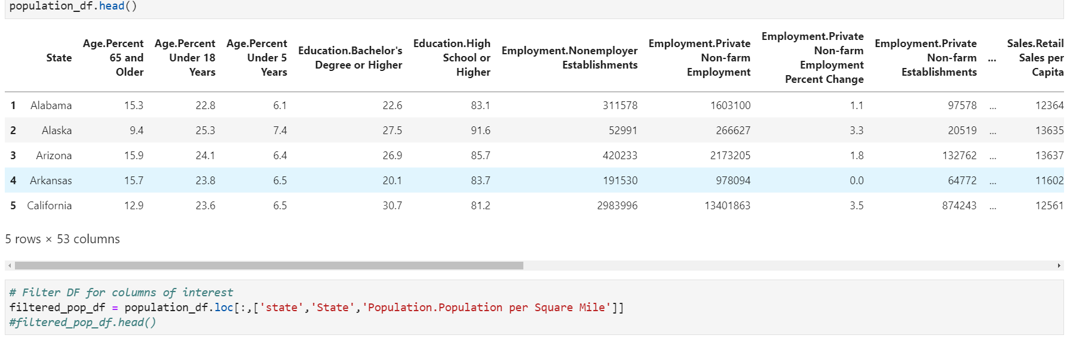
Filtering the Dataframe

Slide 13
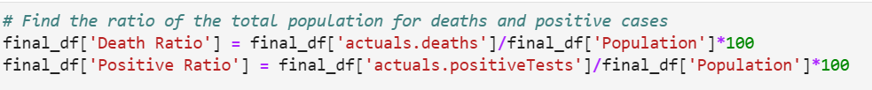
Converting Data to Ratios

Slide 14
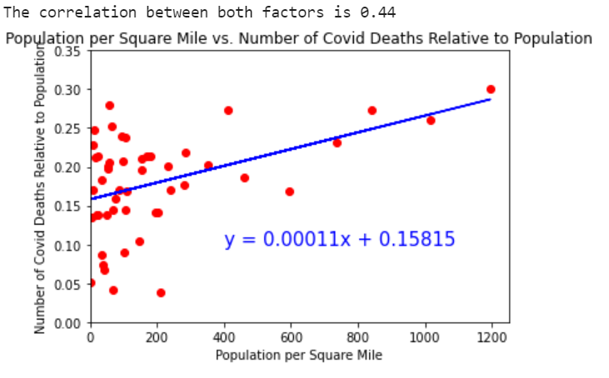
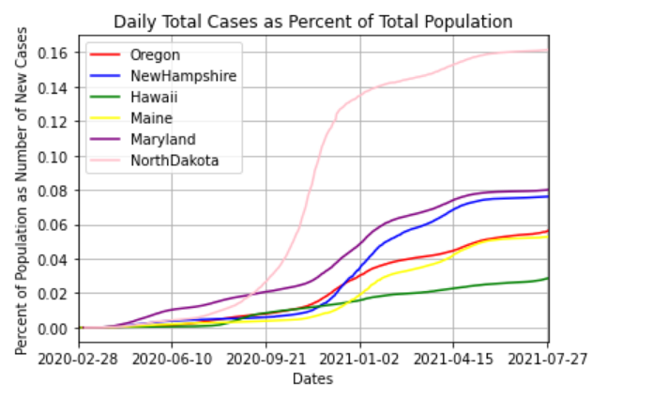
Data Cleanup and Organization
Our analysis can be split into two parts:
Summary analysis
Time series analysis

Slide 15
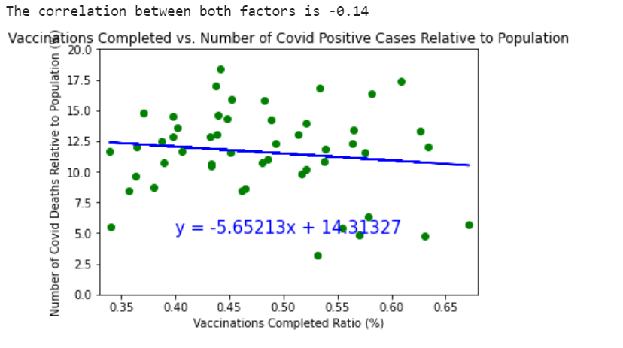
Analysis (Summary Data)

Slide 16
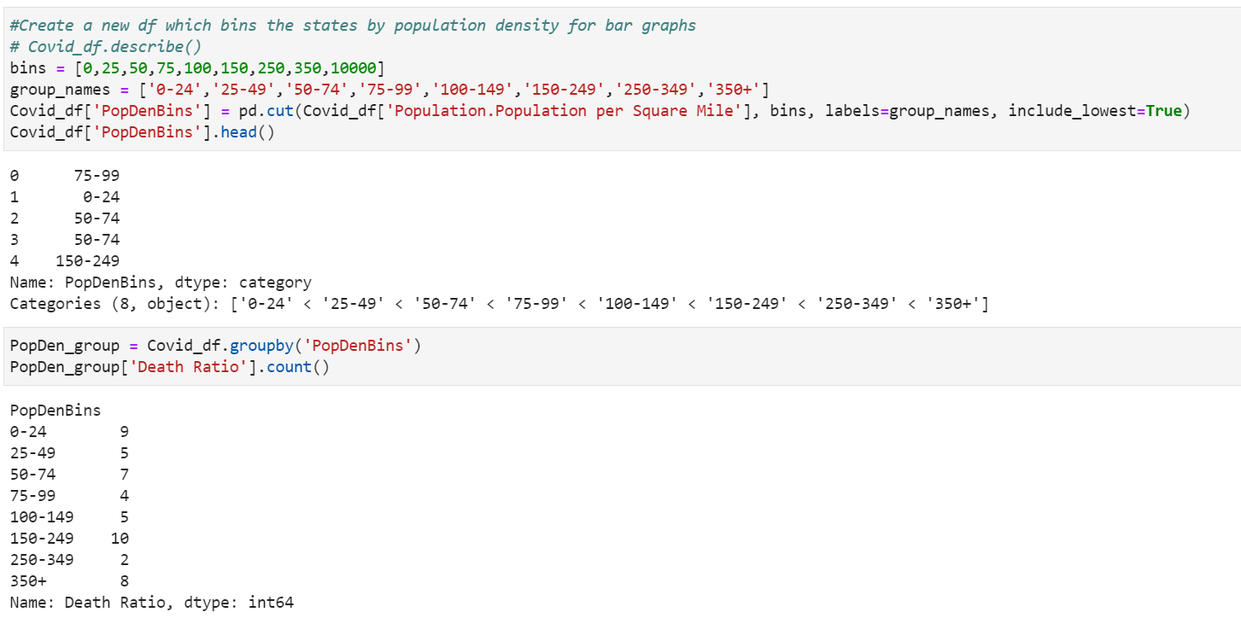
Binning Population Data

Slide 17
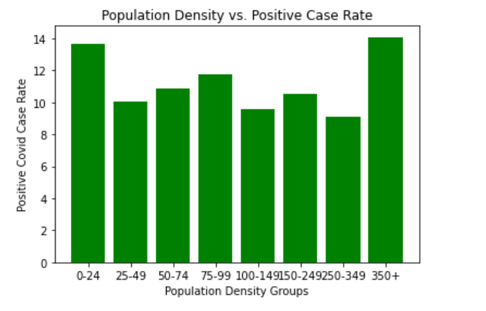
How can we visualize this data?

Slide 18
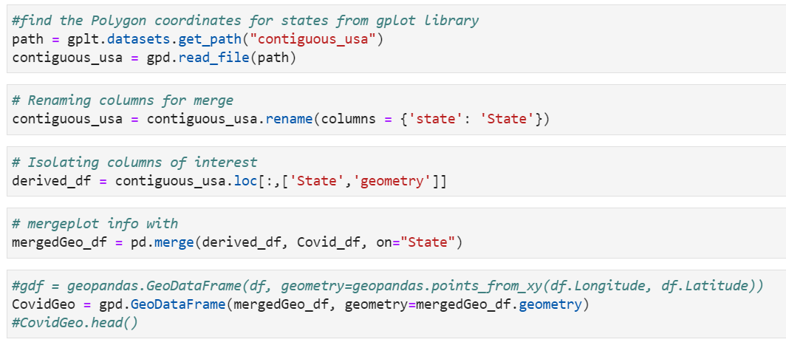
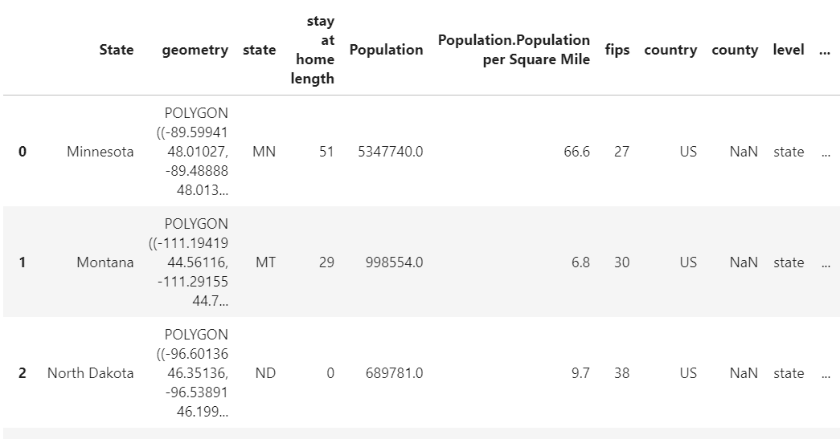
Mapping the Data
Use GeoPlot to plot the shapes of the states
Use geopandas to make a GeoDataFrame
When setting up the data for the geoplotting, we called a dataset that defined the “geometry” of the states.
By merging the states within our COVID dataset and the geoplot dataset, we were able to make a final DF that contained the points necessary to plot out the United States

Slide 19
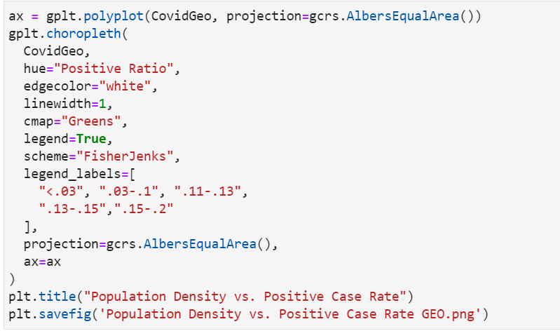
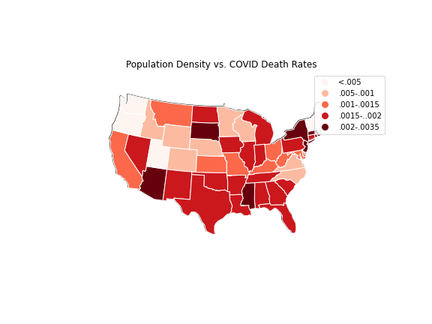
GeoPlot
ax = dataframe with the projection data
gplt.chloropleth: the method of visualization
gcrs.AlbersEqualArea: the globe shape for our projection

Slide 20
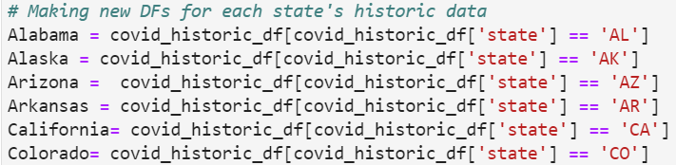
Organizing Time Series Data
The time series DFs had to be split into separate DFs for each state.

Slide 21
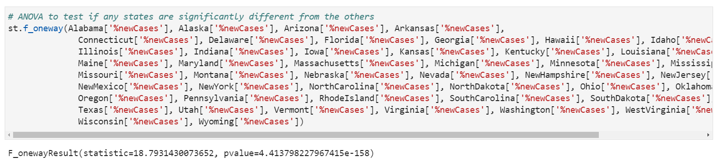
ANOVA

Slide 22
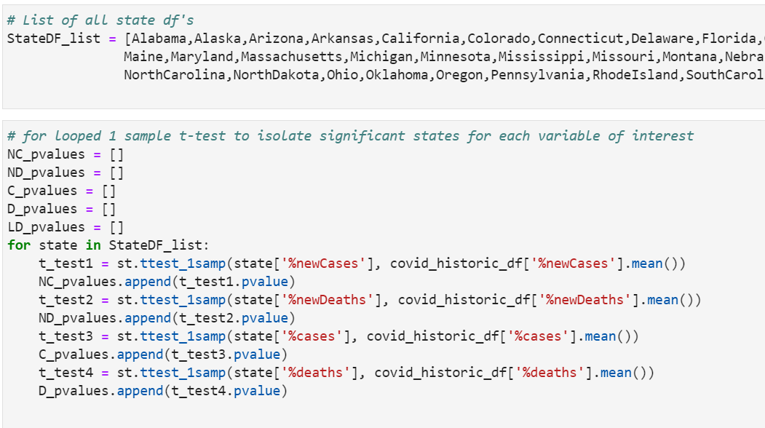
t-test

Slide 23
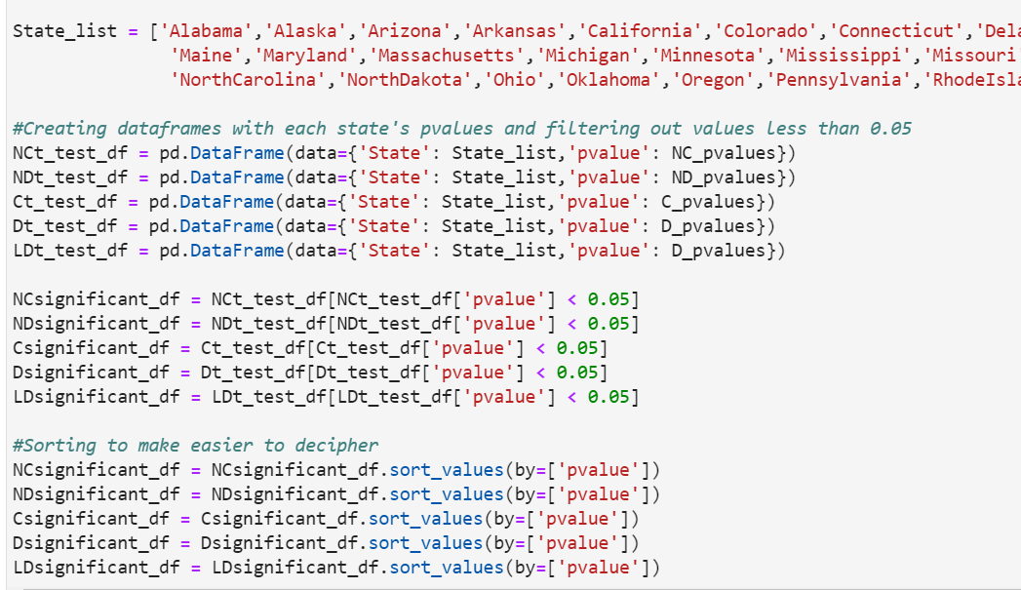
t-test

Slide 24
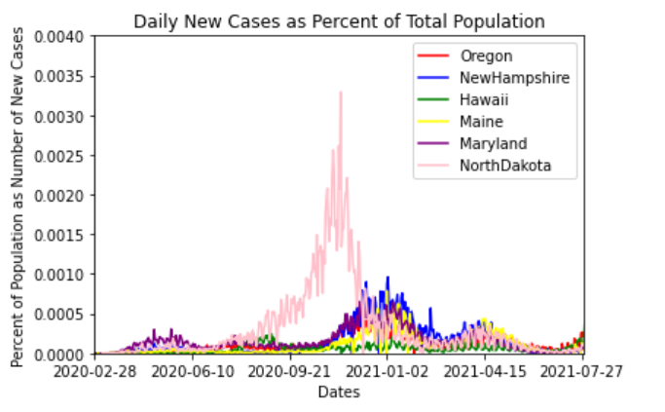
Analysis (Time Series Data)

Slide 25
Conclusions

Slide 26
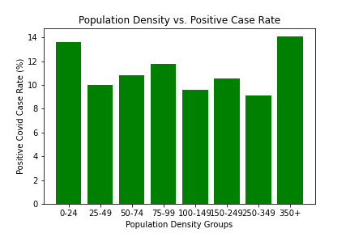

Slide 27
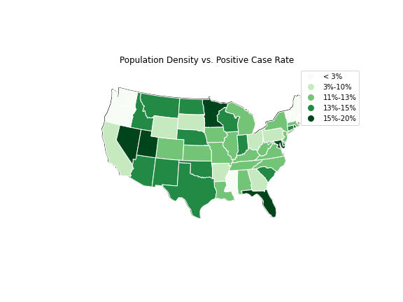

Slide 28
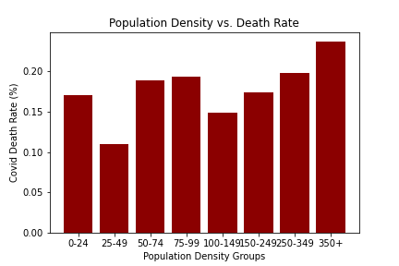

Slide 29
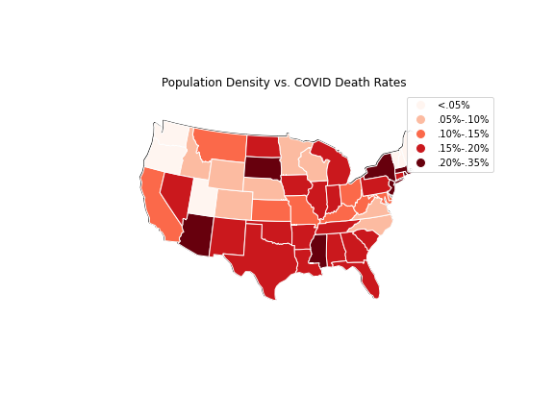

Slide 30
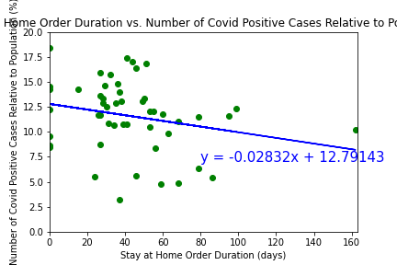

Slide 31
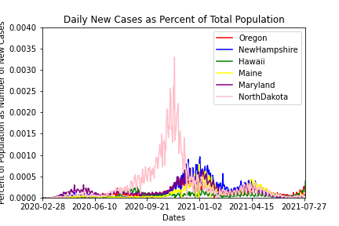

Slide 32
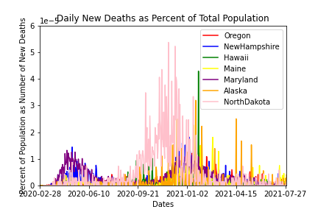

Slide 33
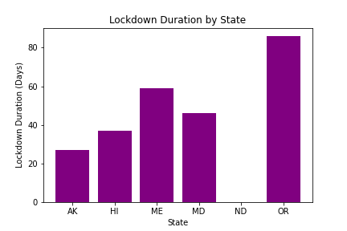

Slide 34
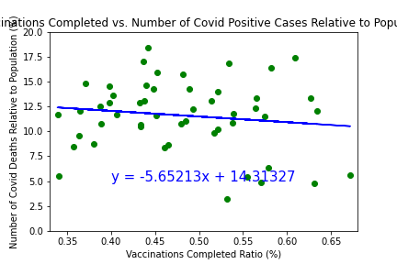
Notes:
The scatter plot here demonstrates the effects of the Covid-19 Vaccines and it’s success in reducing the covid spread throughout the country. We see a regression in cases and we can say that the more vaccines that were completed spurred a reduction in positive cases.

Slide 35
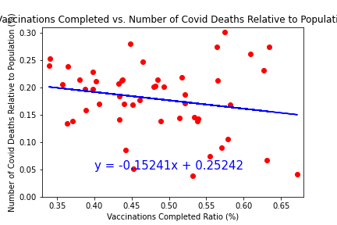

Slide 36
Thank you!
Any Questions?

